Slide 1
Building Office Add-ins for Microsoft Outlook
Add-in Commands and Dialogs

Slide 2

Add-in Commands and Dialogs
Add-in Commands
ExecuteFunction Actions
Dialogs

Slide 3
Add-in commands
Add-in commands
Add-in commands provide an easy way to customize the default Office user interface (UI) with specified UI elements that perform actions.
Add-in commands are configured in the VersionOverrides element of an Add-in manifest.
Add-in commands can extend existing context menus and ribbon tabs/groups or create entirely new custom ribbon tabs/groups.
ExtensionPoint element
The ExtensionPoint element defines where Add-in commands should appear in the Office UI, including in an existing ribbon tab (OfficeTab), a custom tab (CustomTab), or in a context menu from right-clicking in the Office UI (OfficeMenu).
Add-in commands support button and menu controls. Buttons perform a single action and menus provide a submenu of actions.
Commands actions
ShowTaskpane is the most common action for an add-in command. It is used to launch the Add-in in a task pane. Using an add-in command to launch an Add-in is considered a best practice and is incorporated in most Office Add-in templates/generators.
ExecuteFunction is an action that allows an add-in command to execute some script in the background without display any UI. This type of command requires a FunctionFile to be defined in the manifest.
Notes:
Add-in commands
Add-in commands provide an easy way to customize the default Office user interface (UI) with specified UI elements that perform actions.
Add-in commands are configured in the VersionOverrides element of an add-in manifest.
Add-in commands can extend existing context menus and ribbon tabs/groups or create entirely new custom ribbon tabs/groups.
ExtensionPoint elemements
The ExtensionPoint element defines where add-in commands should appear in the Office UI, including in the ribbon (both custom and existing tabs) and context menus from right-clicking in the Office UI.
Add-in commands support button and menu controls, where buttons perform a single action and menus provide a submenu of actions.
.
Commands actions
ShowTaskpane is the most common action for an add-in command. It is used to launch the add-in in a task pane and is part of most Office add-in templates/generators.
ExecuteFunction is an action that allows an add-in command to execute some script in the background without display any UI. This type of command requires a FunctionFile to be defined in the manifest that points to an HTML/JavaScript file

Slide 4
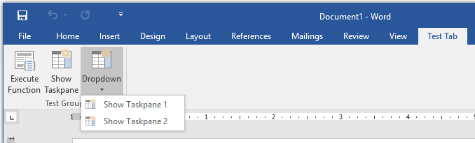
Add-in command in manifest
<ExtensionPoint xsi:type="PrimaryCommandSurface"> <CustomTab id="Contoso.Tab1"> <Group id="Contoso.Tab1.Group1"> <Label resid="Contoso.Tab1.GroupLabel" /> <Control xsi:type="Button” id="Contoso.FuncBtn"> <Label resid="Contoso.FuncBtn.Label" /> <Action xsi:type="ExecuteFunction"> <FunctionName>writeText</FunctionName> </Action> </Control> <Control xsi:type="Button" id="Contoso.TaskpaneBtn"> <Label resid="Contoso.TaskpaneBtn.Label" /> <Action xsi:type="ShowTaskpane"> <TaskpaneId>MyTaskPaneID1</TaskpaneId> <SourceLocation resid="Contoso.TP1.Url" /> </Action> </Control> <Control xsi:type="Menu" id="Contoso.Menu"> <Label resid="Contoso.Dropdown.Label" /> <Items> <Item id="Contoso.Menu.Item1"> <Label resid="Contoso.Item1.Label"/> <Action xsi:type="ShowTaskpane"> <TaskpaneId>MyTaskPaneID1</TaskpaneId> <SourceLocation resid="Contoso.TP1.Url" /> </Action> </Item> <Item id="Contoso.Menu.Item2"> <Label resid="Contoso.Item2.Label"/> <Action xsi:type="ShowTaskpane"> <TaskpaneId>MyTaskPaneID2</TaskpaneId> <SourceLocation resid="Contoso.TP2.Url" /> </Action> </Item> </Items> </Control>
1
2
1
2
3
3
1
2
1
2
*Parts of manifest omitted for readability
Notes:
I know this is an eye-chart, but I wanted to highlight how the manifest can be used to extent the Office ribbon.
The portion of manifest shown defined on ExtentionPoint of type PrimaryCommandSurface, which means the ribbon.
Within the ExtensionPoint the CustomTab element is used, which means the add-in will have it’s own custom tab. To extend an existing tab, the OfficeTab element would be used
The custom tab has one group containing three root controls…two buttons and menu.
The menu contains two buttons of its own

Slide 5
ExecuteFunction Actions
manifest.xml
fnFile.html
<FunctionFile resid="Contoso.FnFile.Url" /> ...
<Control xsi:type="Button" id="Contoso.FnBtn"> <Label resid="Contoso.FnBtn.Label" /> <Icon> <bt:Image size="16" resid="Contoso.FnBtn.Icon" /> <bt:Image size="32" resid="Contoso.FnBtn.Icon" /> <bt:Image size="80" resid="Contoso.FnBtn.Icon" /> </Icon> <Action xsi:type="ExecuteFunction"> <FunctionName>doStuff</FunctionName> </Action> </Control> ...
<Resources> <bt:Urls> <bt:Url id="Contoso.FnFile.Url” DefaultValue="https://aka.ms/FnFile.html" /> ...
<script>
(function () { // Must call Office.initialize
Office.initialize => (reason) { // Initialize stuff
};
})();
// Function must be global
function doStuff(event) {
// Do stuff with Office.js
}
</script>
Notes:
I wanted to show an example using an ExecuteFunction add-in command. This type of commend has three parts
You need a function file, which is an HTML page with a script block. That script block MUST call Office.initialize and should globally expose any functions you want to call from a command button.
You need to define that function file in the add-in manifest
You need button with an action of type ExecuteFunction with a FunctionName pointing to the global function you want it to invoke.

Slide 6
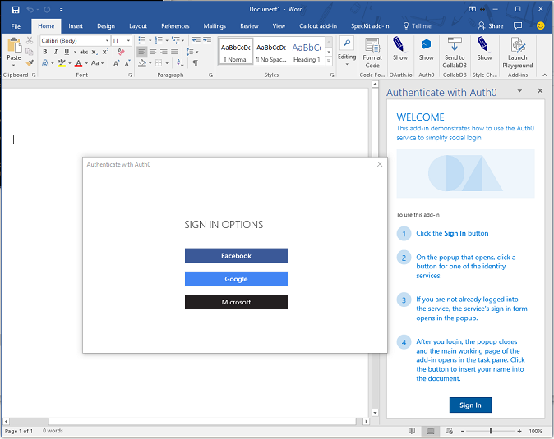
Dialogs
The Dialog API enables a dialog box to be opened from an Office Add-in and is an extension of the UX you can customize in Office.
A primary scenario for the Dialog API is to enable authentication with 3rd party providers, where app domains might not be predictable or displayable in a frame.
The Dialog API can provide additional screen real estate for elements difficult to view in a traditional task pane or content Add-in.
The Dialog API must be launched with a known app domain, but can immediately go to any website (or other resource) that uses HTTPS.
Notes:
The Dialog API is and extension of the user experience you can customize in Office. You can use it to open dialogs from your add-in that interact with the user and your main add-in UX.
The primary scenario for the dialog API is authentication with 3rd party providers. Most identity providers prevent their sign-in experiences from being displayed in an iframe due to click-jacking concerns. This is troublesome with an add-in as they are displayed in iframes in some of the clients such as Office Online. Another challenge with authentication scenarios is predicting the domains that will need to load. In federated sign-in scenarios the potential list of domains could be endless, which again is troublesome in an add-in where all domains need to be registered in the manifest.
It is important to note that Office offers a single sign-on experience specific for Microsoft identities. So if you add-in requires data about the Office user or their resources accessible through Microsoft Graph, such as Office 365 or OneDrive, we recommend that you use the single sign-on API whenever you can. If you use the APIs for single sign-on, then you will not need the Dialog API.
Beyond authentication, the dialog API can provide additional screen real estate for elements difficult to display in a traditional task pane of content add-in. A good example would be hosting a video that would be too small if confined to a task pane
As suggested when I mentioned federated scenarios…the dialog API can display ANY https webpage, but you must launch it to an app domain first and then redirect.

Slide 7
Opening dialogs
Office.context.ui.displayDialogAsync("<URL />", options, optionalCallback);
URL
The dialog should initially open to a page hosted from an app domain (as defined in manifest).
The dialog can display any page that is hosted securely (HTTPS).
Options
Display options include dialog height and width (in % of device screen), which by default are 80% of the height and width of the device screen.
A displayInIframe option can be set to display as a floating iframe rather than an independent window (in clients that support this), which makes it open faster.
Optional Callback
The optional callback allows a host page (the page that opens the dialog) to listen for messages from dialog.
Notes:
Here is the script used to display a dialog from an Office add-in. Notice it takes three parameters:
The URL is the page you want displayed in the dialog…it most initially be a page hosted from an app domain as defined in the manifest. However, you can immediately redirect to a different page.
The options parameter allows the developer the modify the size of the dialog. By default, the dialog will display as 80% of the height and width of the device screen. The values for height and width are expressed that way…as % of the device screen. You can also optionally set the displayInIframe property in the options. Setting this to true will cause the dialog to display as a floating iframe rather than an independent window (in clients that support this), which makes it open faster.
The optional callback allows you host page to respond to messages and events from the dialog…we will look into that more next.

Slide 8
Dialog input/output
/******* Start Host page script *******/
// Open the dialog passing the parameter id=123 let dialog = null; Office.context.ui.displayDialogAsync('https://domain/popup.html?id=123’, {height: 45, width: 55}, function(result) { dialog = result.value; // Listen for messages coming from the dialog dialog.addEventHandler( Microsoft.Office.WebExtension.EventType.DialogMessageReceived, processMessage); });
function processMessage(arg) { // Log the message send from the dialog and close the dialog console.log(arg.message); dialog.close(); } /******* End Host page script *******/
/******* Start Dialog page script *******/ // Dialog must call Office.initialize Office.initialize = function() { // Send the parent/host a message Office.context.ui.messageParent(‘Hello from the dialog!!!‘); } /******* Start Dialog page script *******/
Points of interest
The primary way to pass information to a dialog is through local storage (ex: window.localStorage) or URL parameters in the dialog URL.
A dialog can pass messages back to the host by calling Office.context.ui.messageParent and sending either a Boolean or string value to the host page.
The messageParent function can only be called on a page with the same domain (including protocol and port) as the host page.
The host page must “listen” for messages by subscribing to the DialogMessageReceived handler.
Notes:
Points of interest
The primary way to pass information to a dialog it through local storage (ex: window.localStorage) or through URL parameters in the dialog URL. In this sample, the host page is passing an id of “123” to the dialog via a url parameter.
A dialog can pass messages back to the host by calling Office.context.ui.messageParent to send either a Boolean value or a string message (including stringified object) to the host page. At the bottom of the sample you can see the dialog script where it is passing the message “Hello from the dialog!!!” to the parent.
The messageParent function can only be called on a page with the same domain (including protocol and port) as the host page.
The host page must “listen” for messages by subscribing to the DialogMessageReceived handler. In the sample, the host page registers this handler using the processMessage function, where it simply logs the message.

Slide 9
Demo
Notes:
In this demo, we will explore add-in commands, dialogs, and function files in a mail add-in for Outlook

Slide 10

Summary
Add-in commands provide ways to initiate specific add-in actions from the ribbon by adding buttons or drop-down menus
Outlook supports add-in commands with ExecuteFunction actions for operations that don’t need a UI
The dialog API in Office.js provides a safe dialog for capturing/displaying information that may not work in a tradition add-in UX

Slide 11
Reading further
Add-in commands
https://docs.microsoft.com/en-us/office/dev/add-ins/outlook/add-in-commands-for-outlook
Add-in Dialogs
https://docs.microsoft.com/en-us/javascript/api/office/office.ui?view=office-js#displaydialogasync-startaddress--options--callback-
ExecuteFunction Actions
https://docs.microsoft.com/en-us/outlook/add-ins/add-in-commands-for-outlook#what-ux-shapes-exist-for-add-in-commands

Slide 12
Thank you

